Slide 1
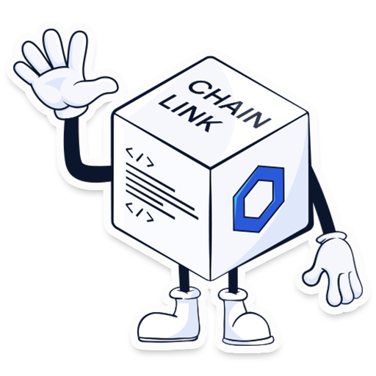
Blockchain Introductory Workshop – Powered by AI

Slide 2
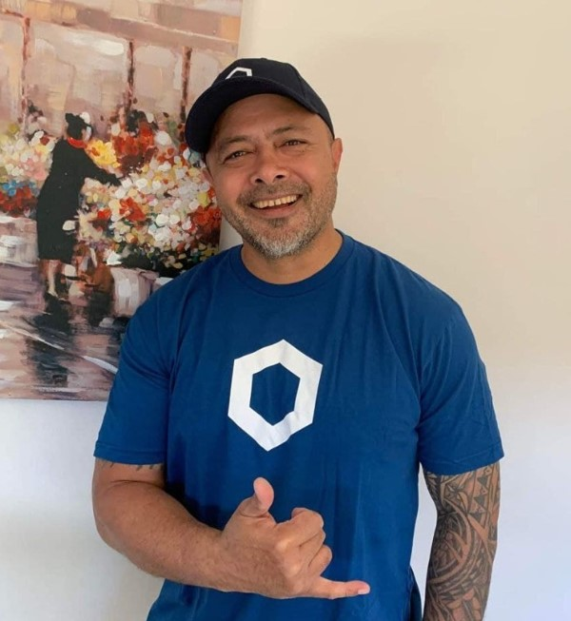

Edwin Liava’a
Chainlink Developer Expert
edwin.liavaa@proton.me
@EdwinLiavaa
Edwin.Liavaa

Slide 3
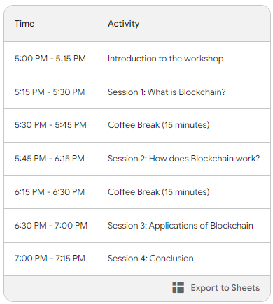
Schedule

Slide 4
AI – Assistants, Blockchain Tools and Resources
ChatGPT https://openai.com/blog/chatgpt
Bing Chat https://www.bing.com/search
FreedomGPT https://chat.freedomgpt.com
Google Bart https://bard.google.com
Anthropic's Claude https://claude.ai
Opera Aria https://www.opera.com/features/aria
Metamask https://metamask.io
Alchemy Sepolia Faucet https://sepoliafaucet.com
Infura Sepolia Faucet https://www.infura.io/faucet/sepolia
Chainlink Faucets https://faucets.chain.link
Chainlink Education https://chain.link/education
Consensys Academy https://courses.consensys.net
Alchemy University https://university.alchemy.com
Web3 University https://www.web3.university

Slide 5
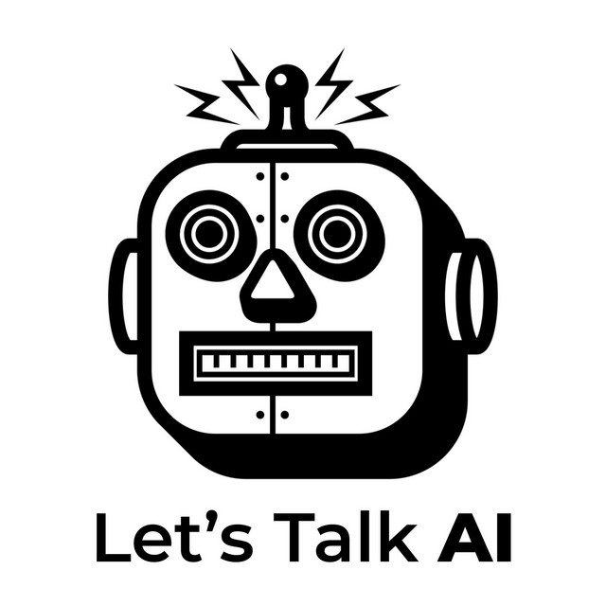
Introduction
Blockchain, as a distributed ledger technology (DLT), has an interesting history that spans several decades.
So, let’s ask AI?
Prompt> Hello AI, what is a Distributed Ledger Technology (DLT)? Step by Step
Prompt> Thank you AI, can you explain the history of the evolution of Blockchain as a Distributed Ledger Technology (DLT)? Step by Step
Prompt> Thank you AI, can you give me a definition of Blockchain?

Slide 6
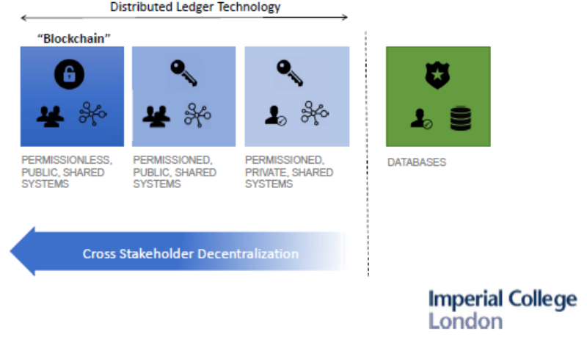

Slide 7
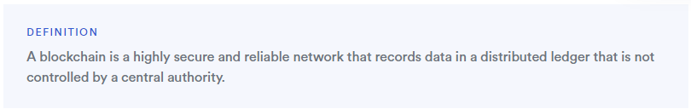
What is Blockchain?
Source: https://chain.link/education-hub/blockchain

Slide 8
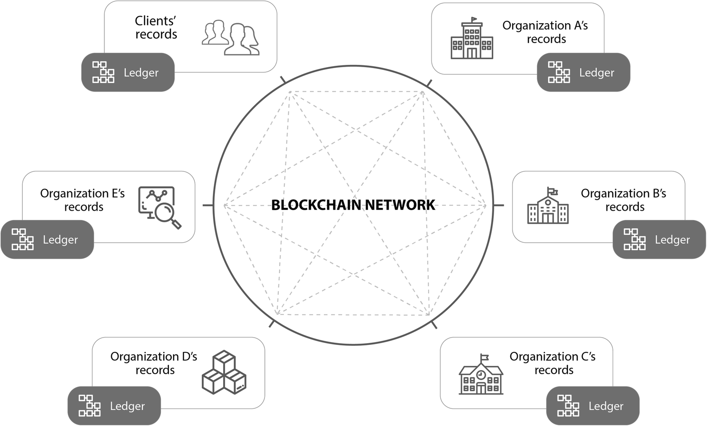
Source: https://link.springer.com/article/10.1007/s11036-020-01649-6/figures/1

Slide 9
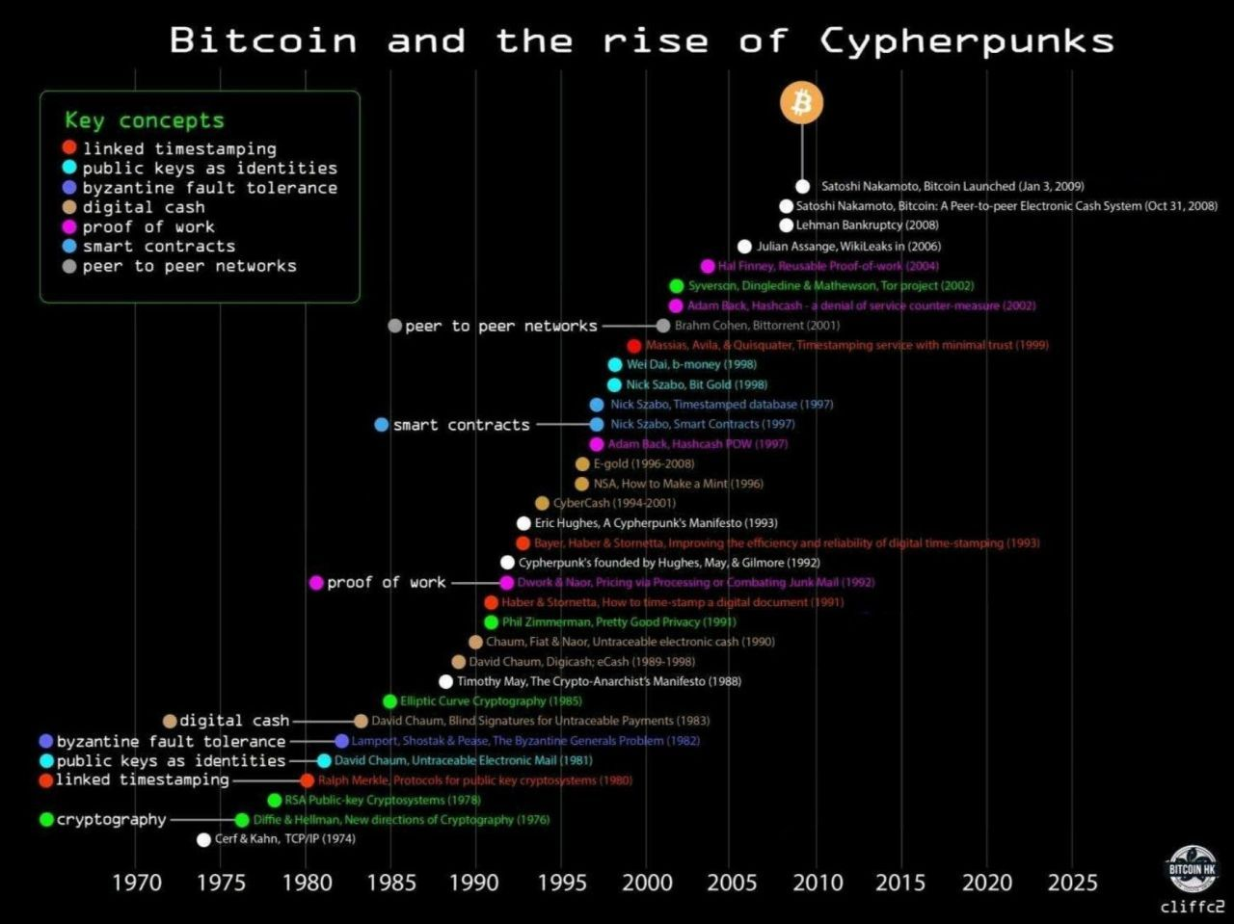

Slide 10
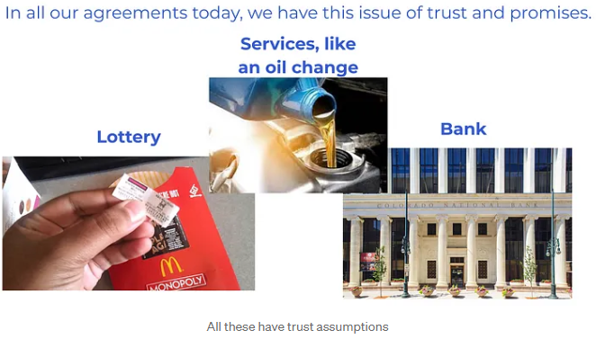
What is the purpose of Blockchain?
Source: https://patrickalphac.medium.com/why-we-web3-bd21a5570019

Slide 11
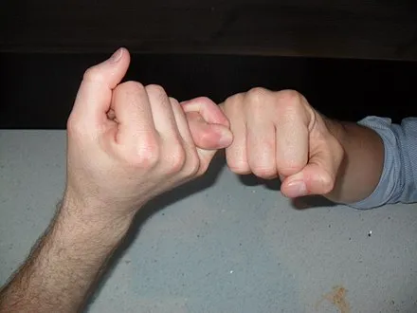
What is the purpose of Blockchain?
“Unbreakable Promises”
Blockchain technology allows us to create agreements and promises that are effectively unbreakable, similar to the childhood ritual of the pinky swear.
Just as the pinky swear signified an unbreakable vow between friends, blockchain provides the tools to make trusted, permanent agreements.
Blockchain gives us the capability to establish commitments that do not require absolute trust between parties.
In a sense, we now have the technology to make pinky swears - symbolic unbreakable promises - actually binding and permanent.
Blockchain enables “trust-minimized agreements” that were not feasible before.
Source: https://en.wikipedia.org/wiki/Pinky_swear

Slide 12
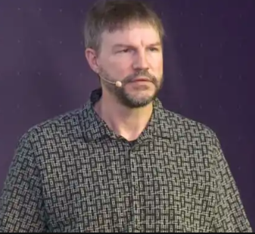
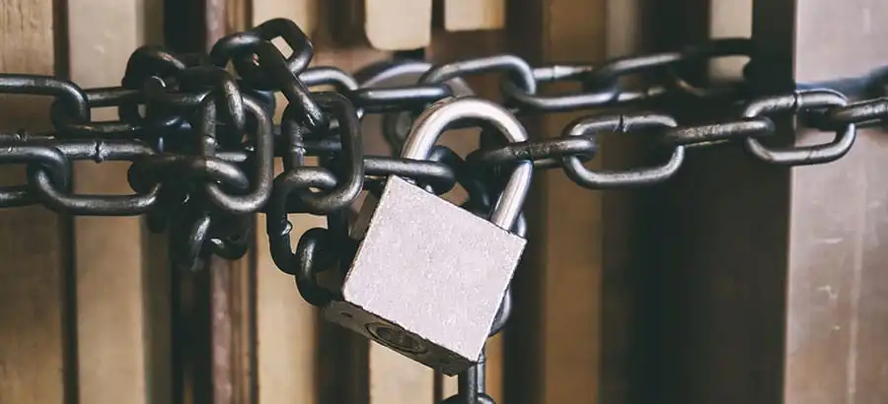
What is the purpose of Blockchain?
“Trust. Minimized. Agreements”
Nick Szabo: The man, the myth the legend.
His paper on Bit Gold and his conception of smart contracts. Bit Gold is seen as the precursor to bitcoin, which Satoshi Nakamoto (pseudonym) would go on to refine in his/her/they bitcoin whitepaper.
Smart contracts, Szabo first wrote about back in 1996, enable the execution of cryptocurrency transactions and underpin the viability of the entire field.
His philosophy as a whole – is the concept of ‘trust-minimisation.’ This posits the theory that, as a species which is optimised to best function in groups of no more than 150 individuals, we need to develop ways in which the need to trust strangers is kept to a minimum.
Quite simply, there wouldn’t be crypto without Nick Szabo’s work.
Source: https://www.coinbureau.com/analysis/who-is-nick-szabo/

Slide 13
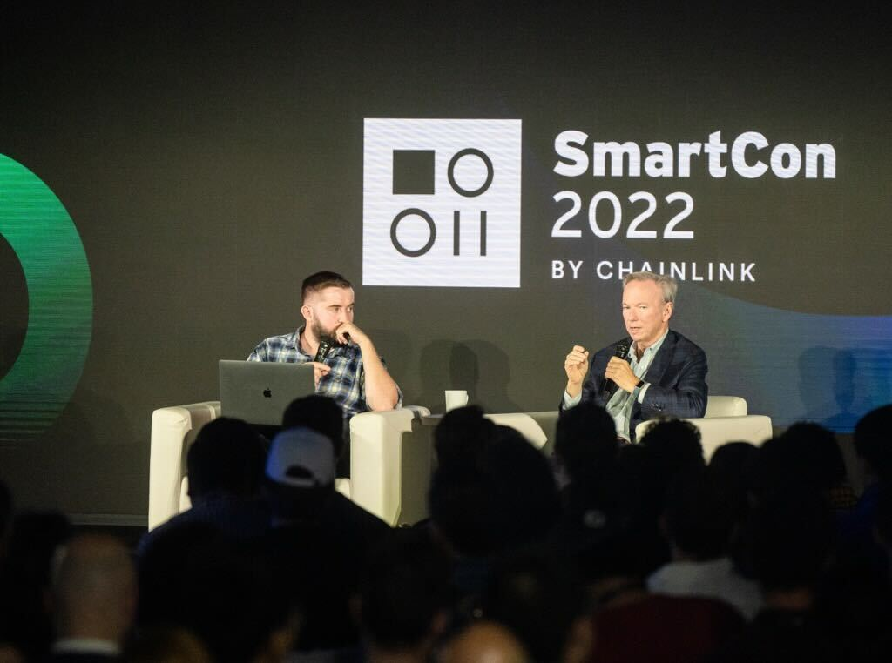
What is the purpose of Blockchain?
“Cryptographic Truth”
Sergey Nazarov: co-founder of Chainlink, a leading decentralized oracle network.
His thesis: Cryptographic truth will reshape societal agreements.
Blockchain technology creates a tamper-proof ledger.
Cryptographic truth can revolutionize trust and enforcement of agreements.
Benefits: Increased security, efficiency, transparency and accessibility.
Applicable to various domains: finance, supply chains, voting systems, legal contracts.
The 4 pillars of good goverance.
Sergey Nazarov and former Google CEO Eric Schmidt discussing the future of Web3.
Source: https://blog.chain.link/smartcon-2022-recap/

Slide 14
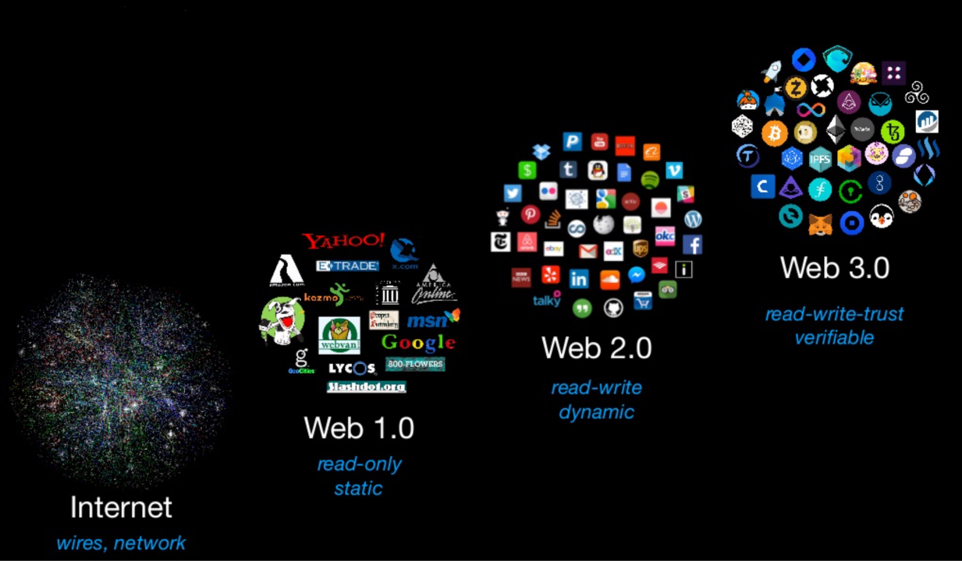
Source: https://www.linkedin.com/pulse/evolution-web-how-web3-changing-internet-we-know-ryan-kirkley/

Slide 15
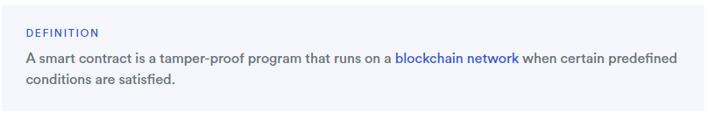

What is a Smart Contract?
A smart contract is an agreement that is deployed to a decentralized blockchain, and unlike traditional agreements, once a smart contract is deployed, it:
Cannot be altered (is immutable)
Automatically executes
Everyone can see the terms of agreement
Source: https://chain.link/education/smart-contracts

Slide 16
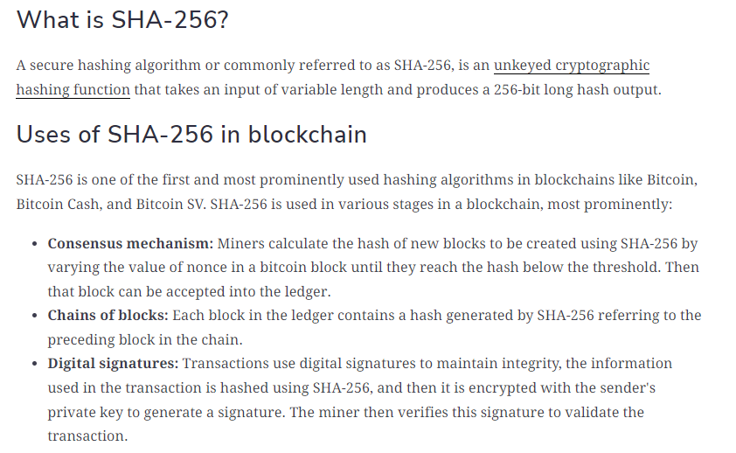
Source: https://www.educative.io/

Slide 17
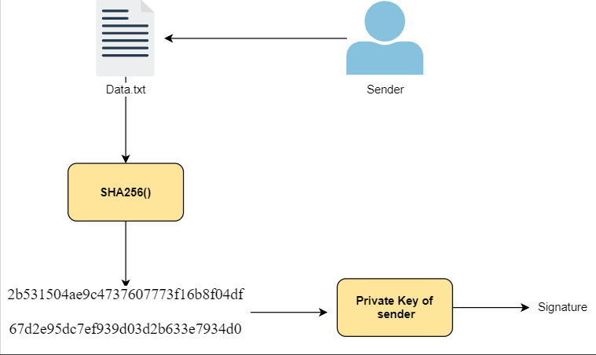

Slide 18
Cryptographic Truth is Strictly Better than “Just Trust Us”
“”Just Trust Us” Paper Promises
Control is completely given away
Counterparty risk is high and opaque
Transparency is purposefully removed
Cryptographic Truth Guarantees
Control is in the user’s hands
Counterparty risk is low and transparent
Transparency is unavoidably built-in

Slide 19
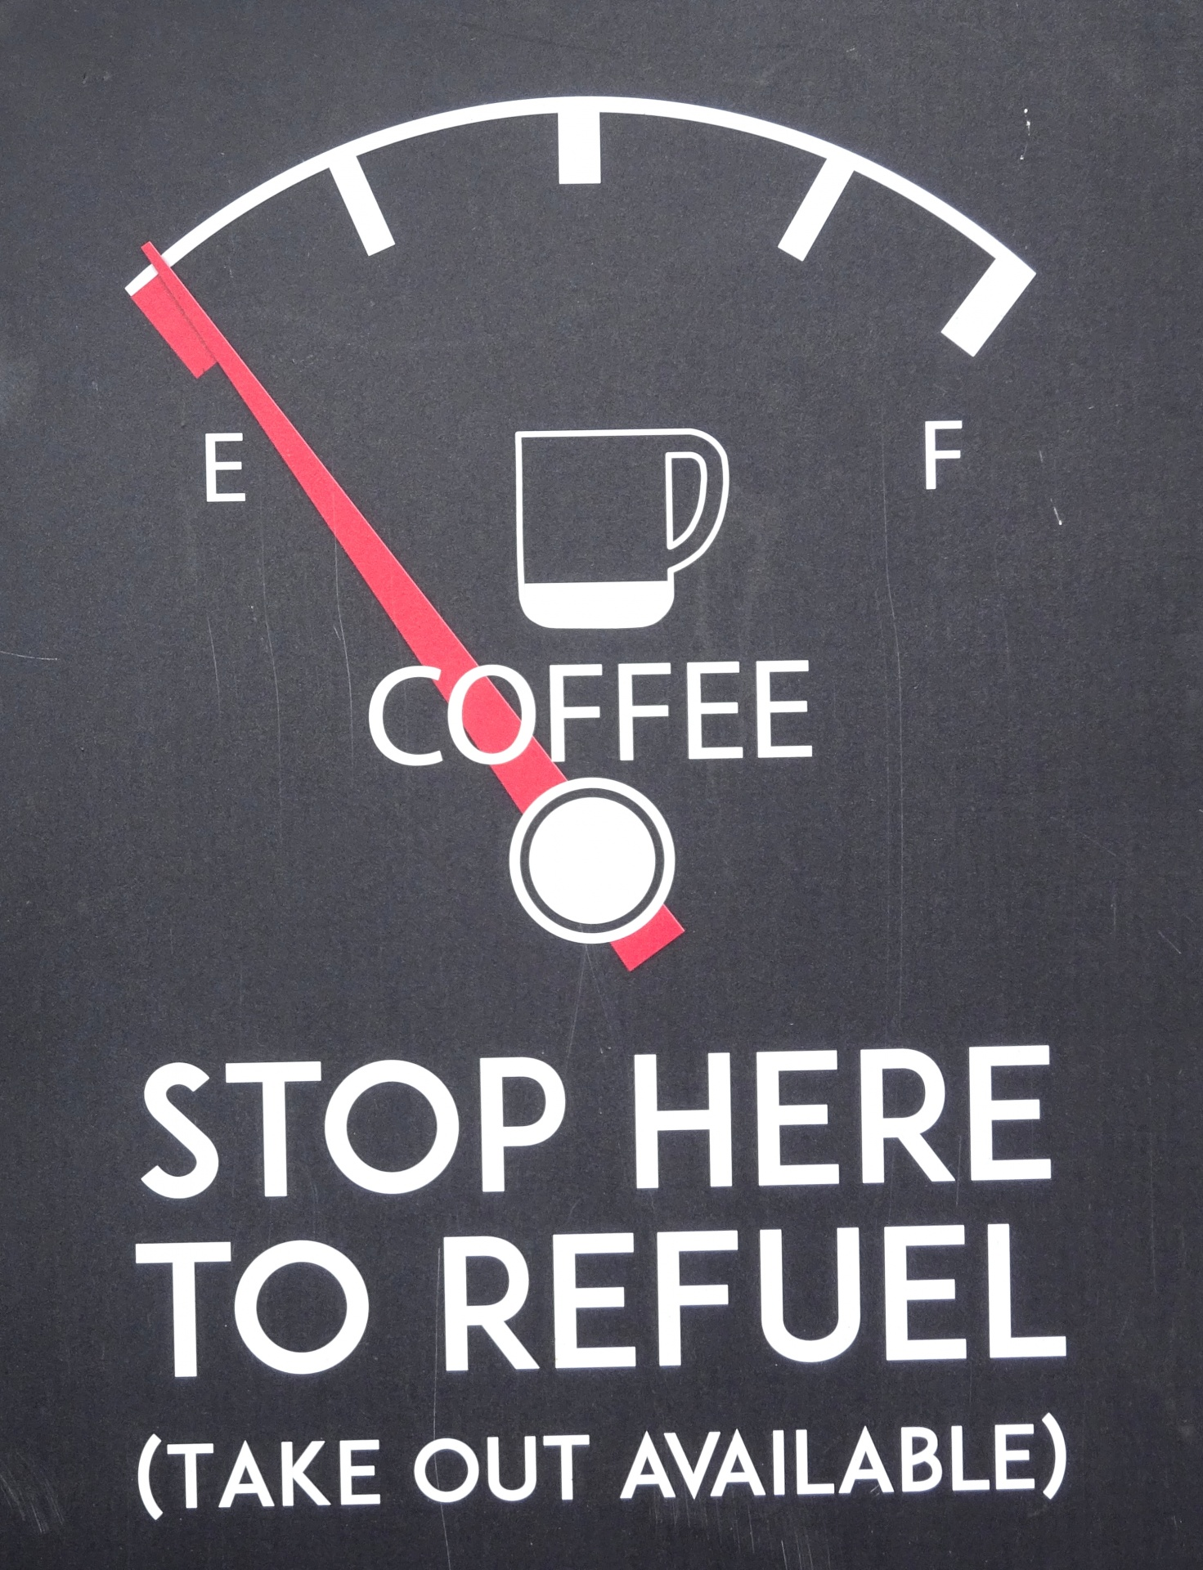

Slide 20
How does Blockchain work?
The 4 Generals Problem and Byzantine Fault Tolerance are two concepts related to distributed systems and consensus algorithms.
So, let’s ask AI?
Prompt> Hello AI, can you explain the relativity of the 4 generals problem and Byzantine Fault Tolerance to how Blockchain works? Step by Step
Prompt> Thank you AI, can you give me a breakdown of how blockchain works? Step by step

Slide 21
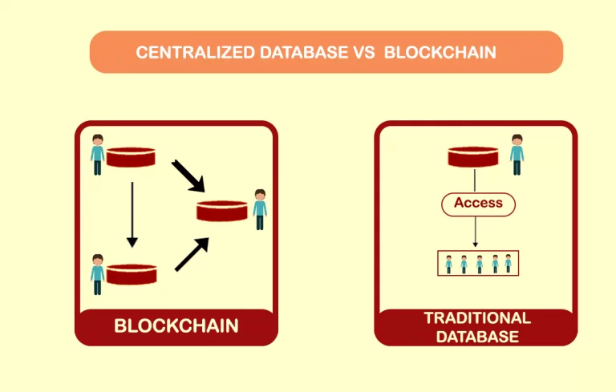
Source: https://hashstudioz.com/blog/what-should-a-startup-choose-between-blockchain-and-a-traditional-database/

Slide 22
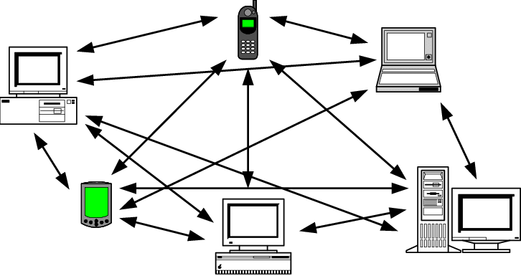
How does Blockchain work? Peer-to-Peer (P2P)
.t57, 56t6
Source: https://www.researchgate.net/publication/2605250_A_distributed_value-oriented_XML_Store

Slide 23
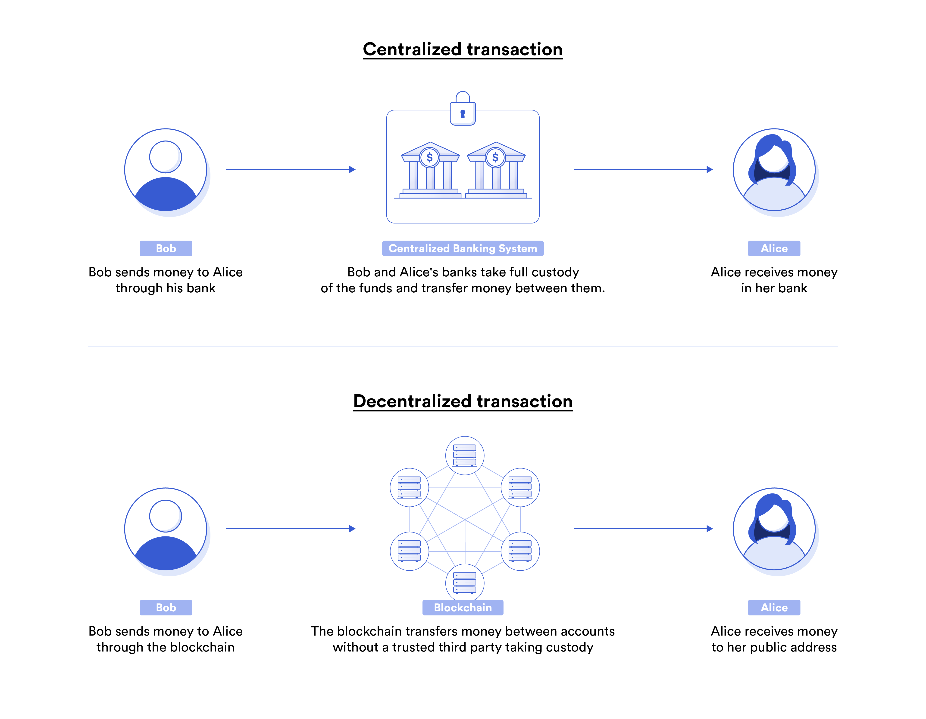
How does Blockchain work?
Source: https://chain.link/education-hub/blockchain

Slide 24
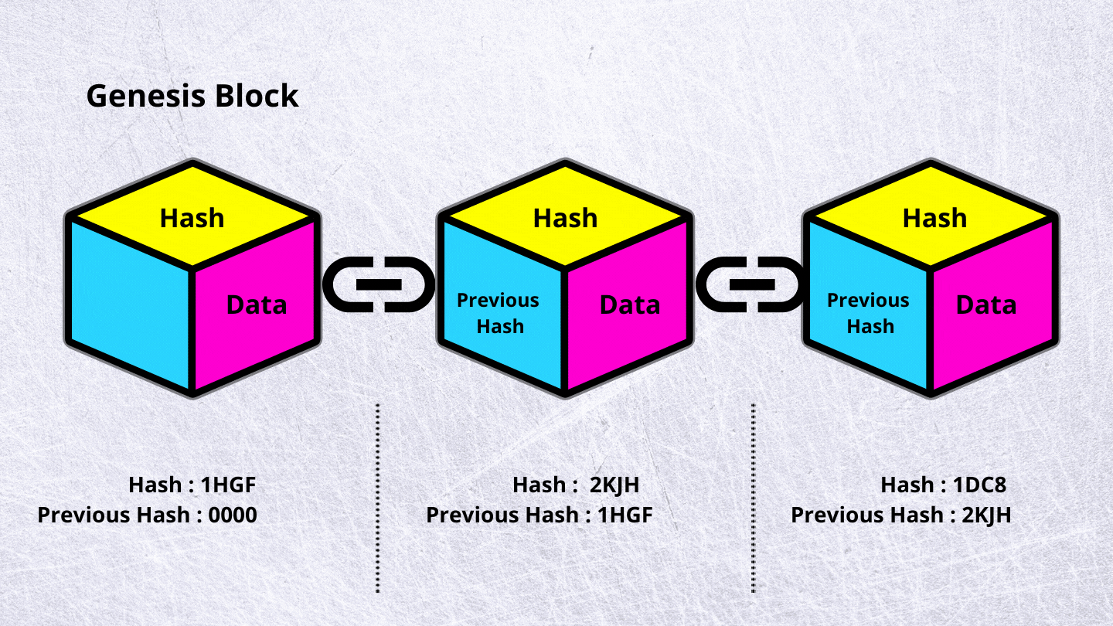
Source: https://medium.com/the-crypto-block/8-concepts-that-will-help-you-understand-blockchain-technology-c51b0941bf19

Slide 25
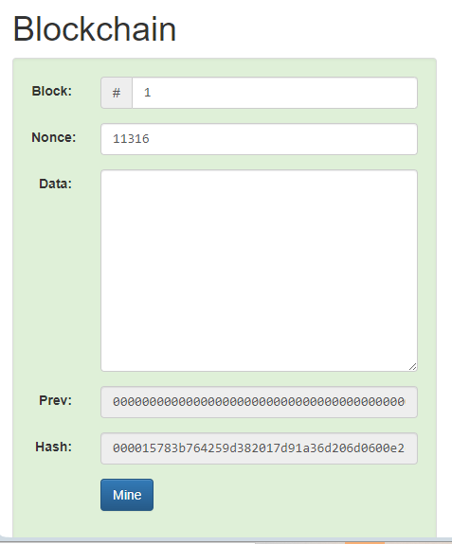
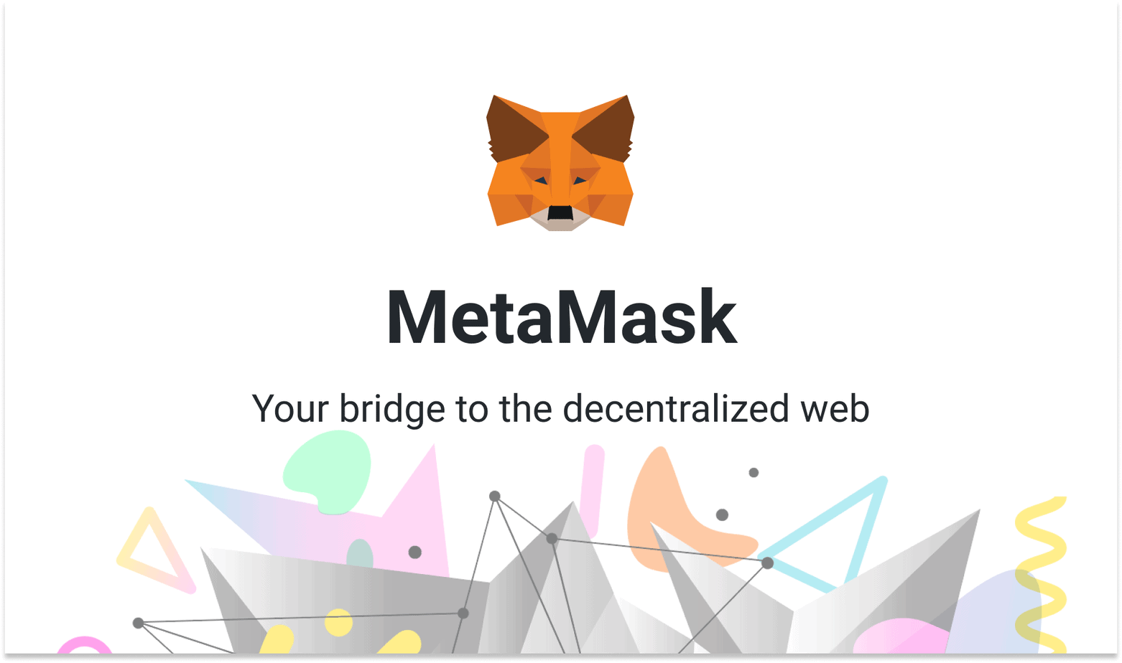
Practical Session
Blockchain Demo - https://demoblockchain.org/hash
MetaMask - https://metamask.io

Slide 27
Applications of Blockchain
What is Adoption?
So, let’s ask AI?
Prompt> Hello AI, can you explain the meaning of “Adoption” in an organisation? Step by Step

Slide 28
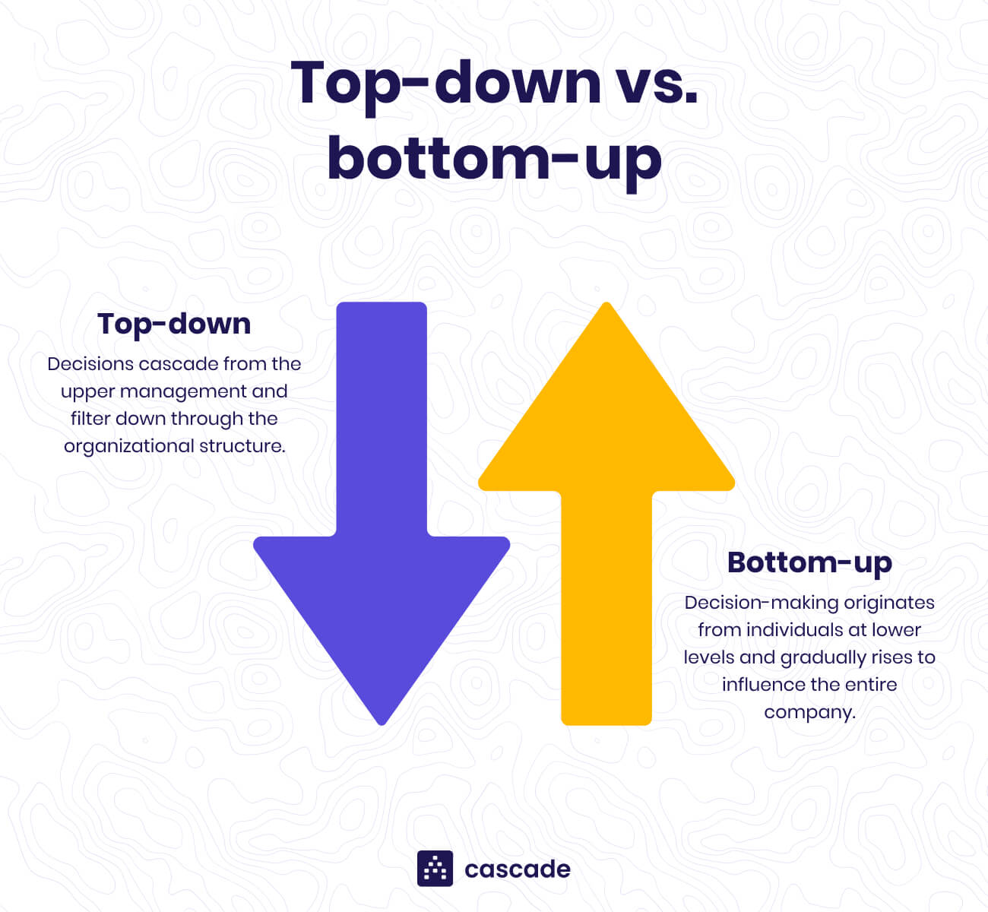
Applications of Blockchain
What is Adoption?
Accepting
Emracing
Starting to use something (Ultimate Decision)
Source: https://www.cascade.app/blog/top-down-vs-bottom-up

Slide 29
Meaning of Adoption in an Organisation
Organisational Level
Awareness
Risk
Value
Accepting
Embracing
Starting to Use
Individual Level

Slide 30
Meaning of Adoption in an Organisation
Organisational Level
Awareness
Risk
Value
Accepting
Embracing
Starting to Use
Individual Level

Slide 31
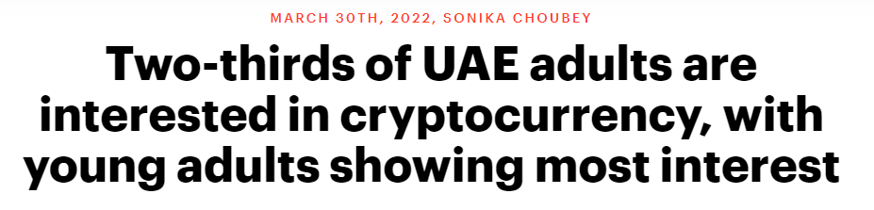
Source: https://business.yougov.com/content/41850-two-thirds-uae-adults-are-interested-cryptocurrenc

Slide 32
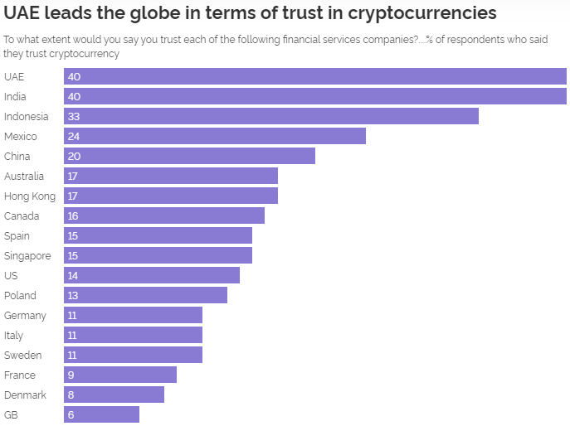
Source: YouGov.com Global Survey 2022

Slide 33

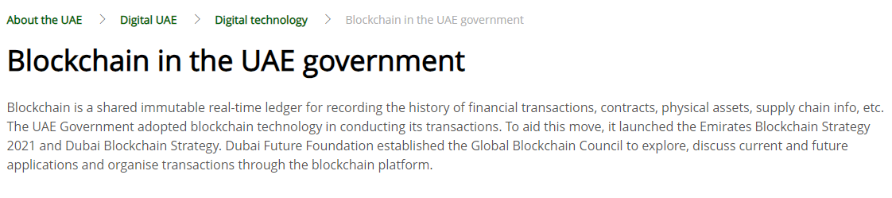
Source: https://u.ae/en/about-the-uae/digital-uae/digital-technology/blockchain-in-the-uae-government

Slide 34
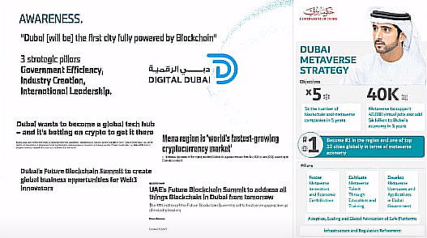

Slide 35
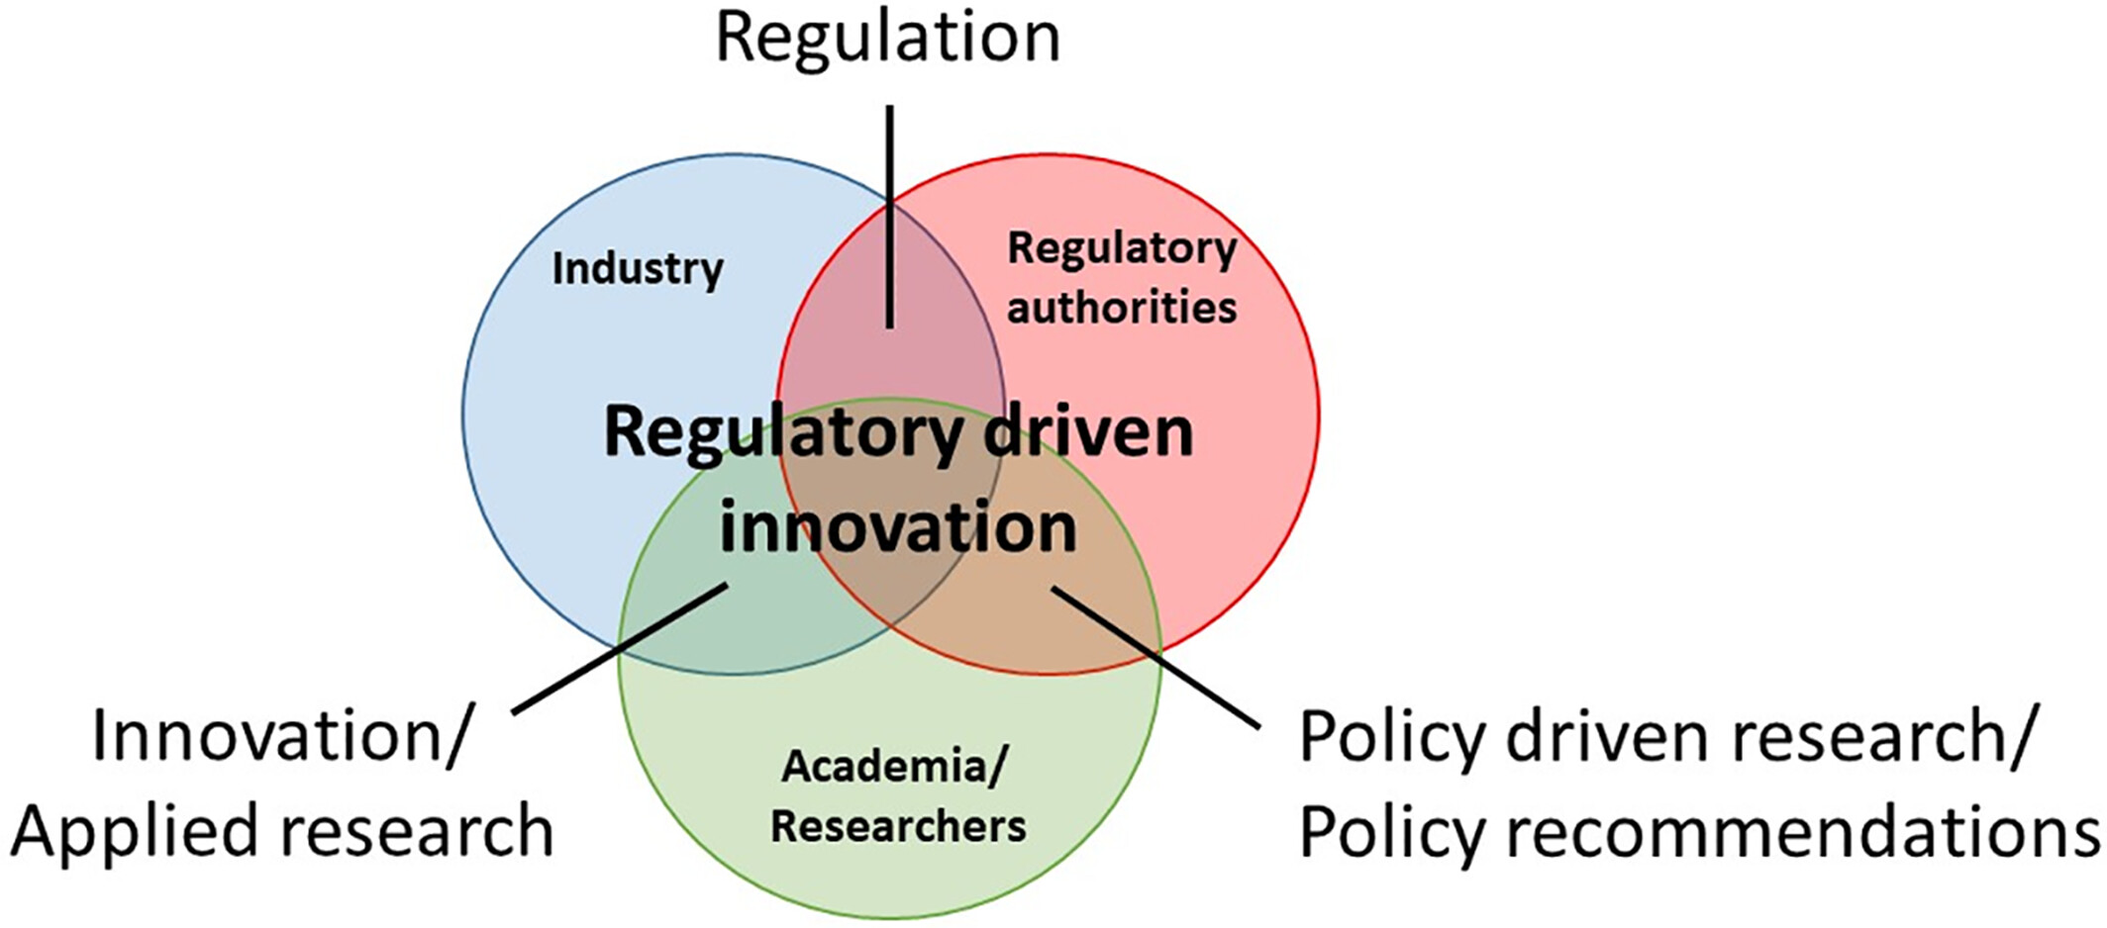
Source: The innovation triple helix depicting the processes of regulatory driven innovation. Modified from Zhou and Etzkowitz (2021)

Slide 36
Meaning of Adoption in an Organisation
Organisational Level
Awareness
Risk
Value
Accepting
Embracing
Starting to Use
Individual Level

Slide 37
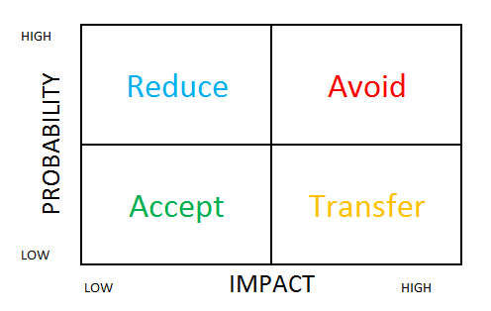
The TARA framework is a tool that can be used to assess and manage risk

Slide 38
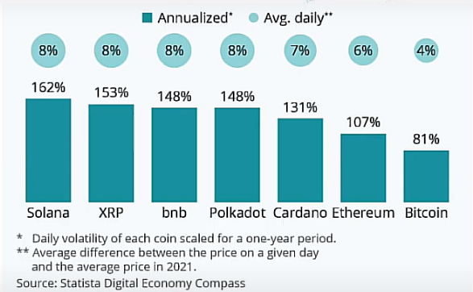
Volatility is the enemy of any business

Slide 39
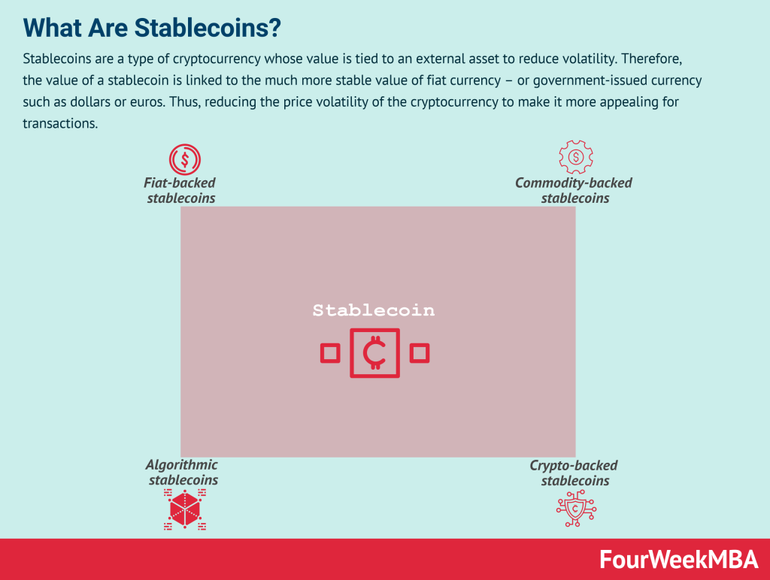
Volatility is the enemy of any business

Slide 40
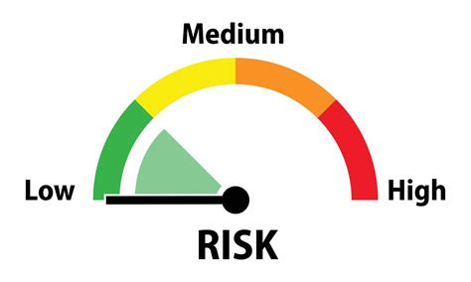
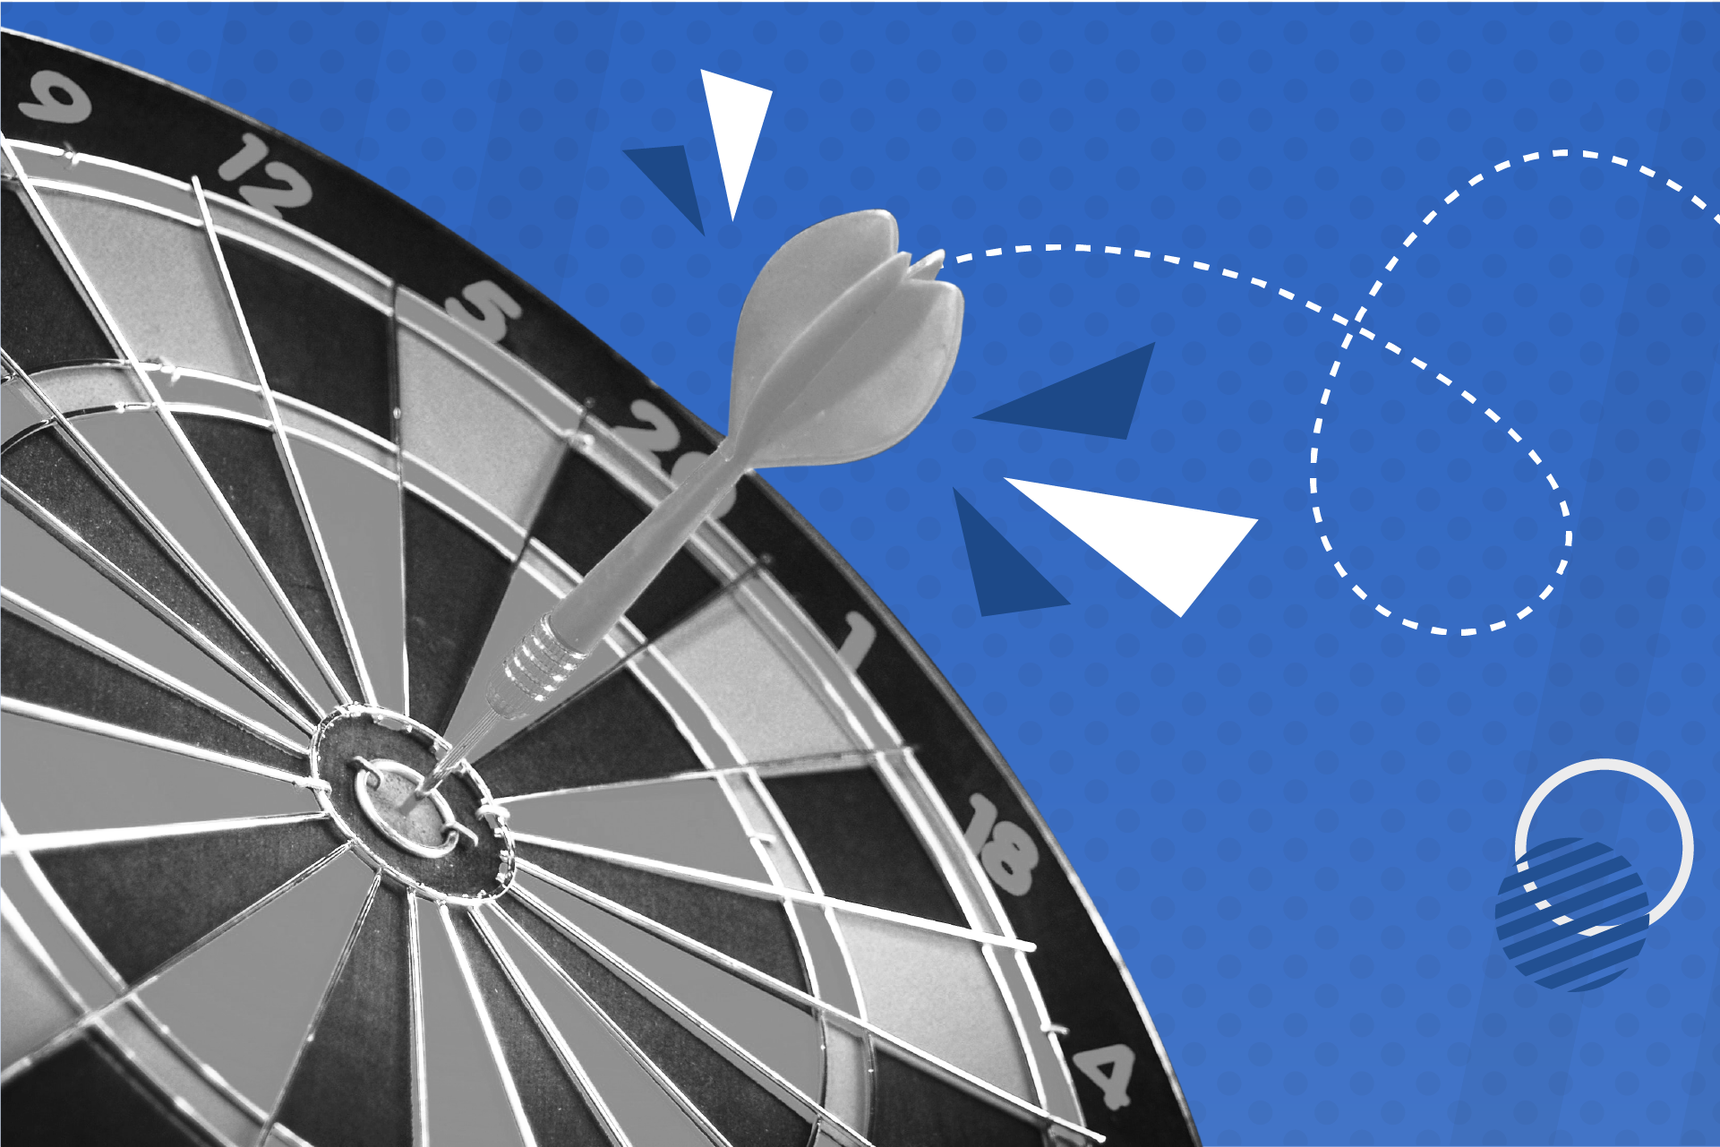
Avoid High Risky Projects
Organisations will adopt Blockchain Projects that are:
Low Risk
Closer to the Core

Slide 41
Meaning of Adoption in an Organisation
Organisational Level
Awareness
Risk
Value
Accepting
Embracing
Starting to Use
Individual Level

Slide 42
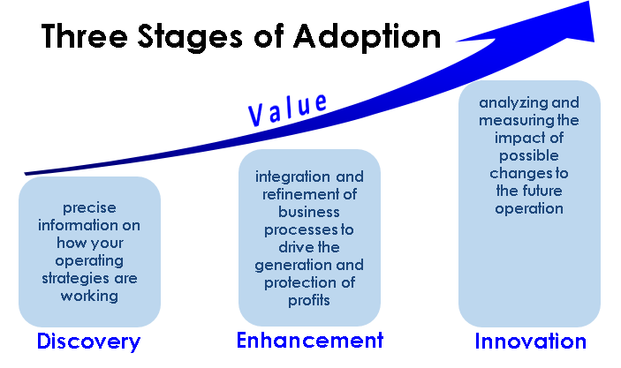
Source: https://blogs.dcvelocity.com/big_data/2014/08/the-journey-understanding-the-path-of-adoption.html

Slide 43
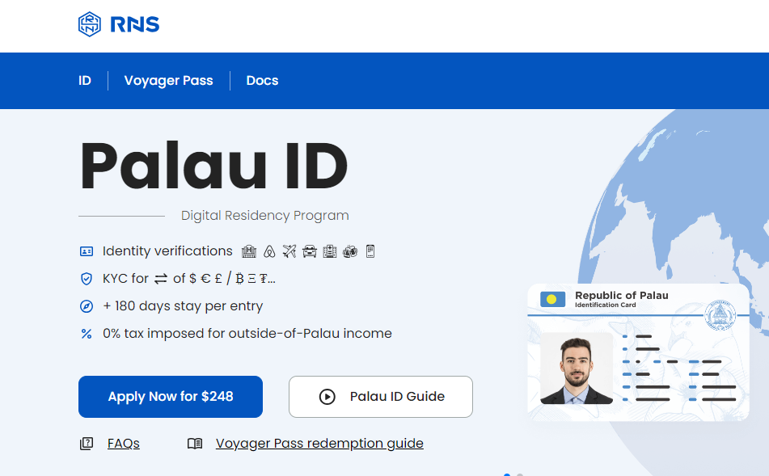
Applications of Blockchain in the Pacific Islands
Source: https://rns.id

Slide 44
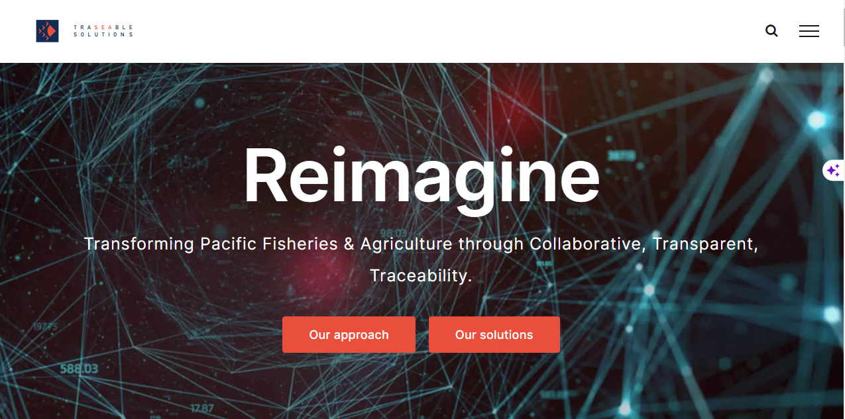
Applications of Blockchain in the Pacific Islands
Source: https://www.traseable.com

Slide 45
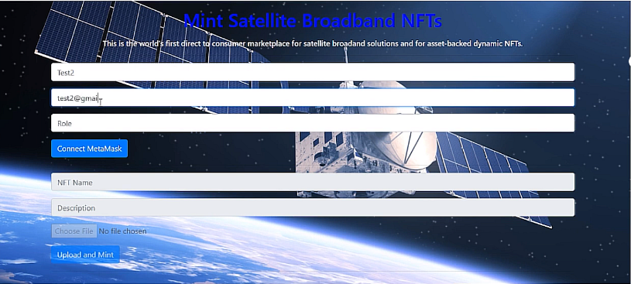
Applications of Blockchain in the Pacific Islands
Source: https://devpost.com/software/blockchain-chainlink-satellite-broadband-supply-chain

Slide 46
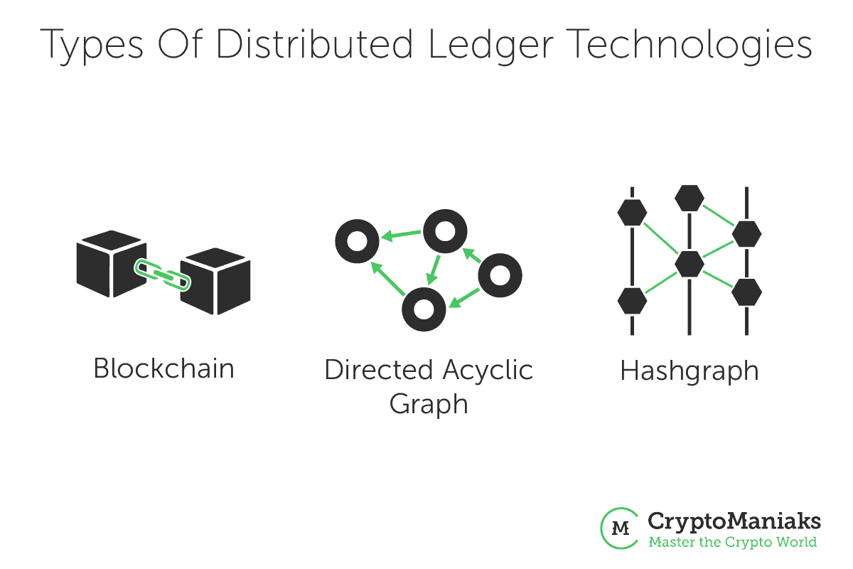
Conclusion

Slide 47
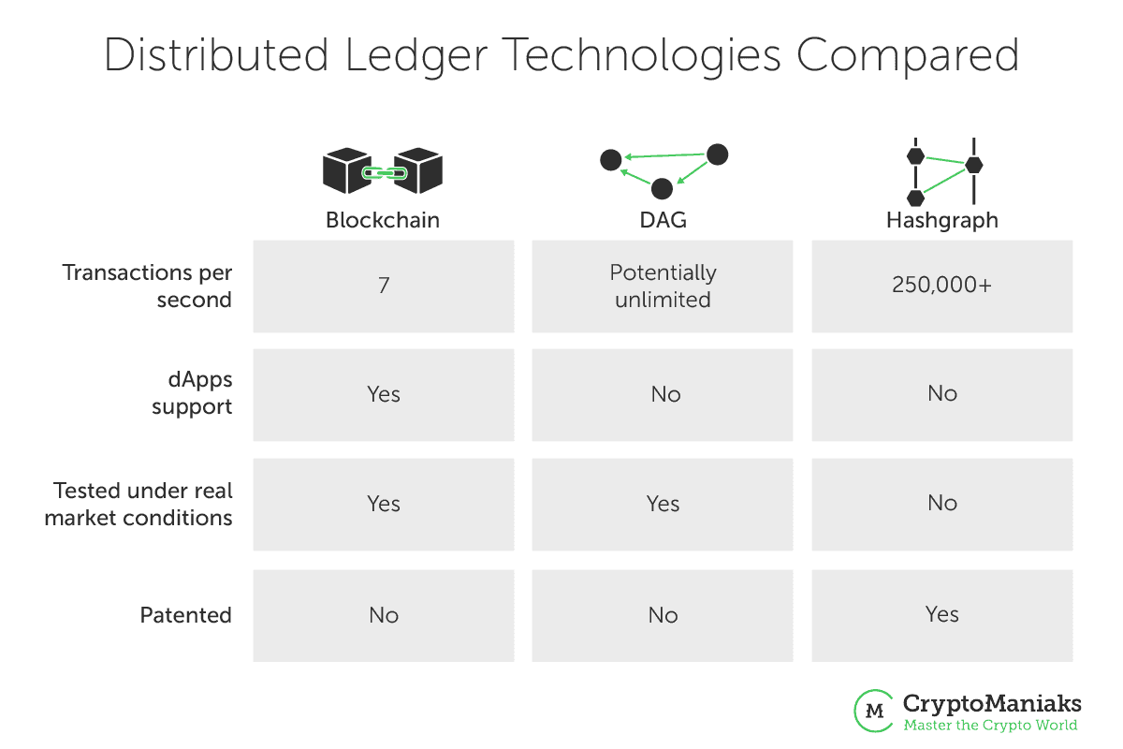

Slide 48
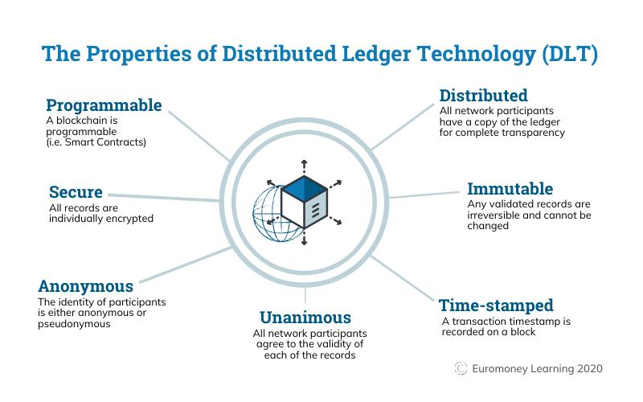
Source: https://phemex.com

Slide 49
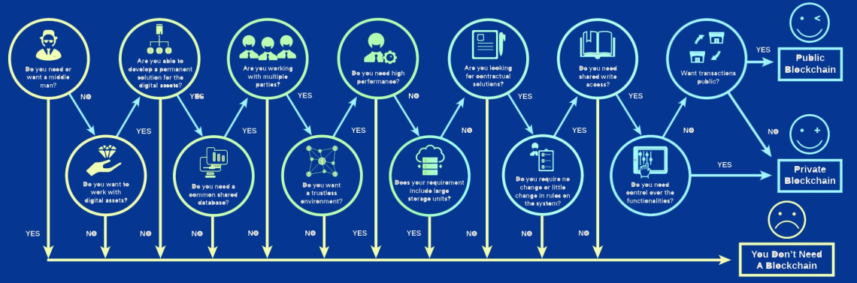
Source: Blockchain Council https://www.blockchain-council.org

Slide 50
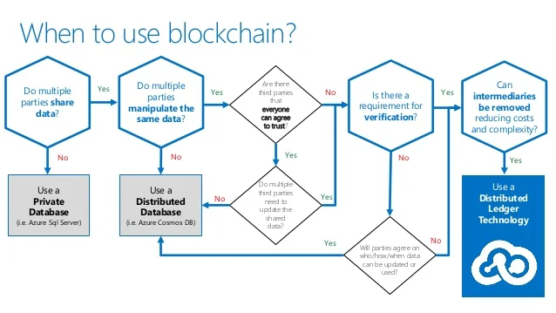
Source: https://www.slideshare.net

Slide 51
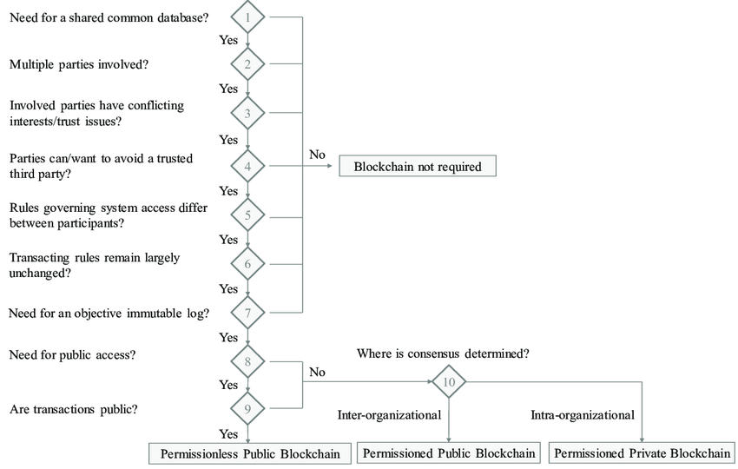
Source: https://www.researchgate.net/figure/Overview-of-the-Blockchain-Decision-Path_fig5_333545589

Slide 52

Homework Practical Session – Web3 101
https://learn.metamask.io/overview

Slide 53
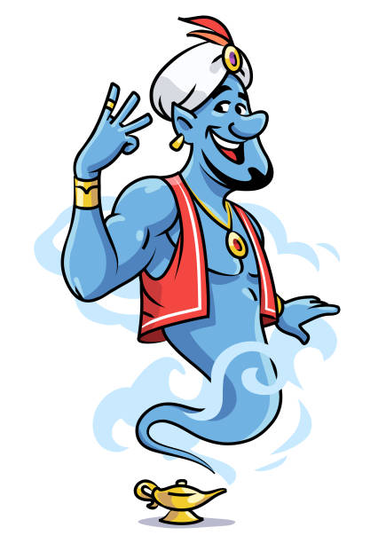
The Genie is out of the bottle
Any Web3 Wishes?
Would you like to learn more about Smart Contracts?
Would you like to learn more about Chainlink?
Would you like to learn more about Crypto?

